Slide 1
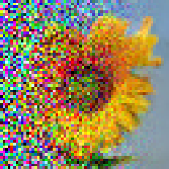
Image Generation with Diffusion Models
Lambda
Márk Somorjai
Zsombor Szommer
Csanád Telbisz

Slide 2
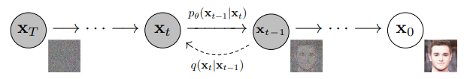
Denoising Diffusion Probabilistic Model
Adding (Gaussian) noise to image
Neural network: learns to predict noise at each small step
Image generation: start from pure noise -> denoise step-by-step
Related Work & Sources:
[1] J. Ho, A. Jain, and P. Abbeel. Denoising diffusion probabilistic models. URL https://arxiv.org/abs/2006.11239
[2] N. Rogge and K. Rasul. The annotated diffusion model, 2022. URL https://huggingface.co/blog/annotated-diffusion
[3] A. Béres. Denoising diffusion implicit models, 2022. URL https://keras.io/examples/generative/ddim/
[4] A. K. Nain. Denoising diffusion probabilistic model, 2022. URL https://keras.io/examples/generative/ddpm/

Slide 3
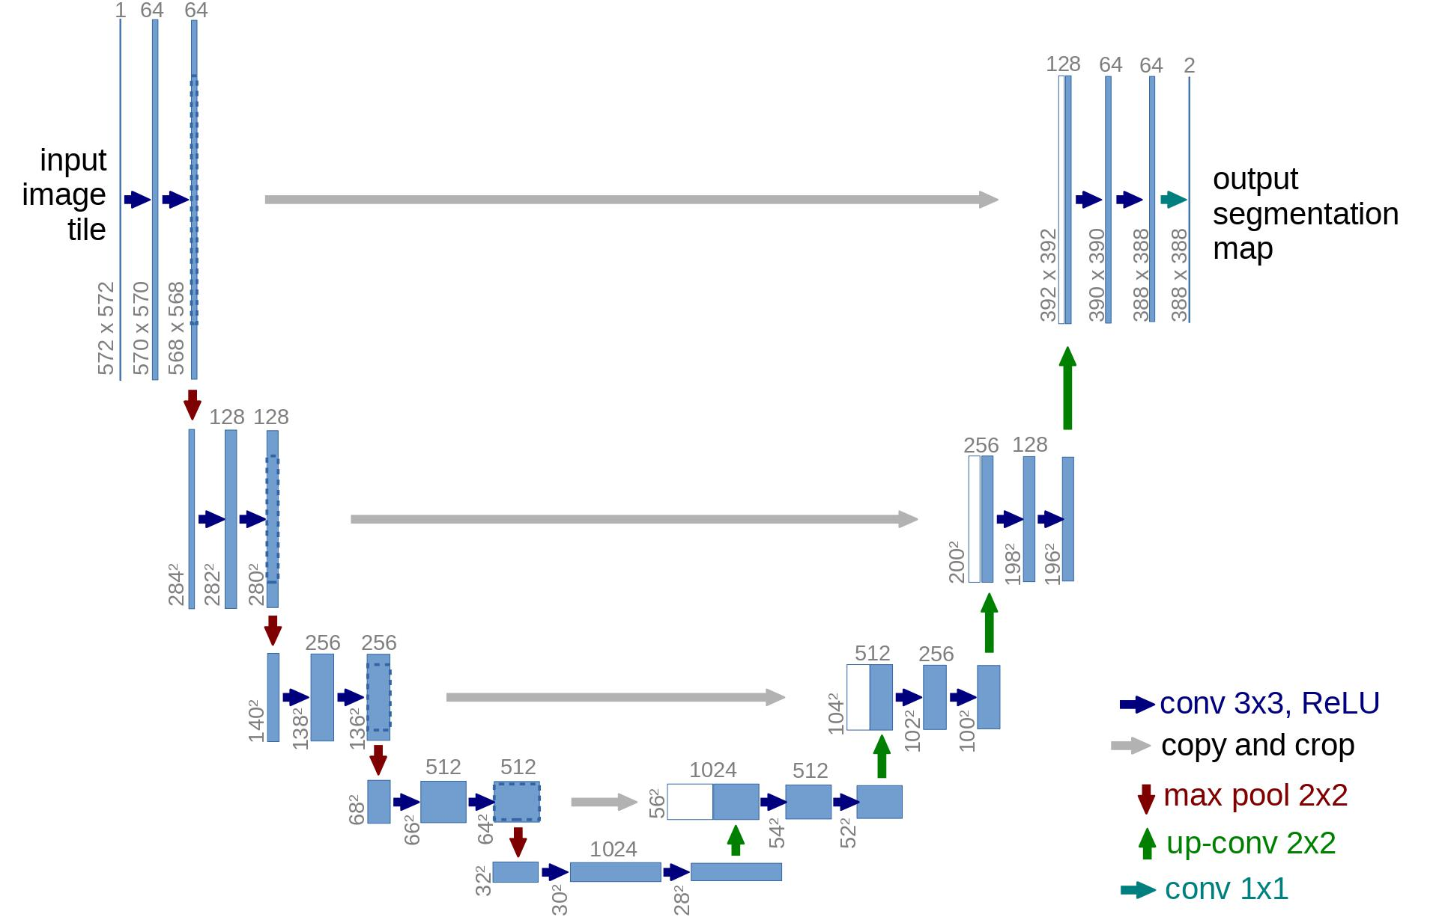
Neural Network
Skip connections
Input:
noisy image
noise level
Output: predicted noise at the level
Architecture: U-NET
Optimizations:
Multiple residual blocks per level
Group normalization
Sinusoidal time (noise level) embedding
Exponential moving average for weight update
Residual block
Source: O. Ronneberger, P. Fischer, and T. Brox. U-net: Convolutional networks for biomedical image segmentation. 2015. URL http://arxiv.org/abs/1505.04597

Slide 4
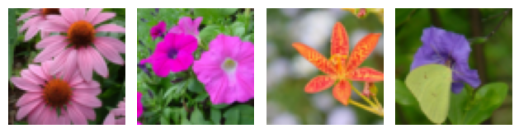
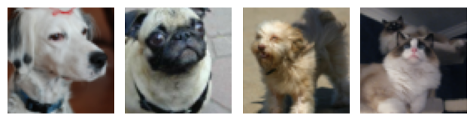
Datasets
Oxford 102 Flower Dataset¹
8189 images of various kinds of flowers
Oxford-IIIT Pet Dataset²
7349 images of cats and dogs
Scaled down and cropped to 64*64 pixels
80%/20% split used for training/validation sets
¹ https://www.robots.ox.ac.uk/~vgg/data/flowers/102/
² https://www.robots.ox.ac.uk/~vgg/data/pets/

Slide 5
Evaluation
Solution written in Jupyter Notebook, wrapped in Docker container
Training
GTX 1070
1000 epochs
Measured metrics:
training loss
validation loss
Kernel Inception Distance¹ (KID)
Subjective evaluation: how flower-like are the generated images?
Smaller, overfit training: 6-8 hours
Training on full dataset: 36 hours
¹ M. Bińkowski, D. J. Sutherland, M. Arbel, A. Gretton: Demistifying MMD GANs (https://arxiv.org/abs/1801.01401)

Slide 6
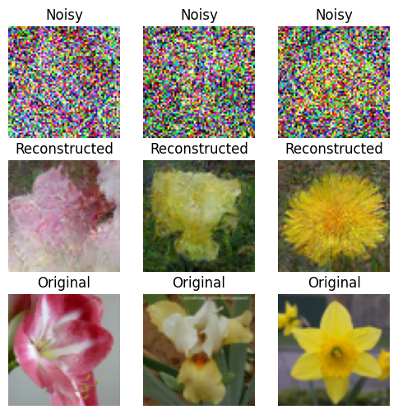
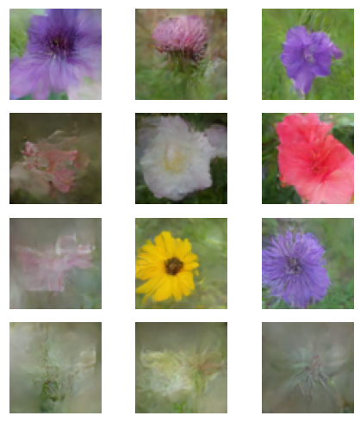
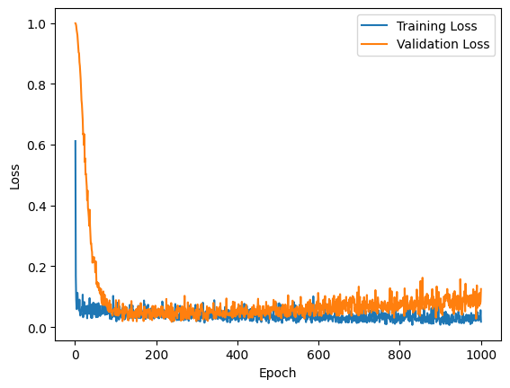
Overfitting the Model
smaller dataset: 1000-1000 training and validation images
Loss
Generation
Reconstruction

Slide 7
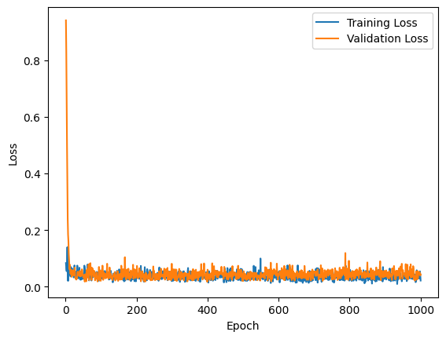
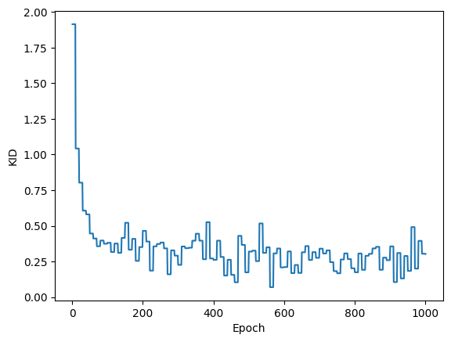
Training on Full Dataset
Loss
measured every epoch
Kernel Inception Distance
measured every 10 epochs
min. validation loss: 0.01702
min. KID: 0.06957

Slide 8
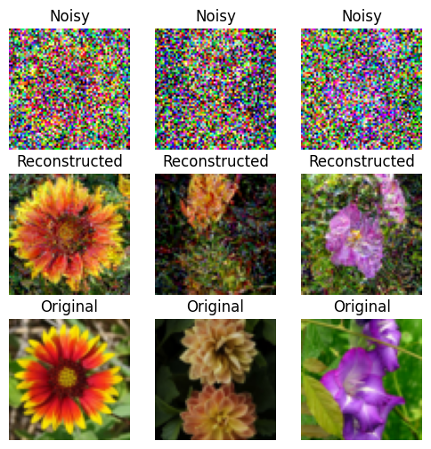
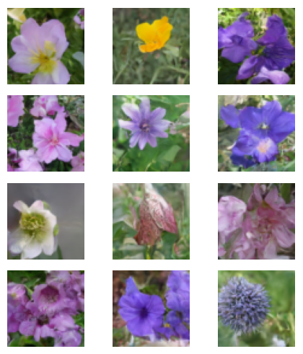

Best KID Model
Generation
Reconstruction

Slide 9
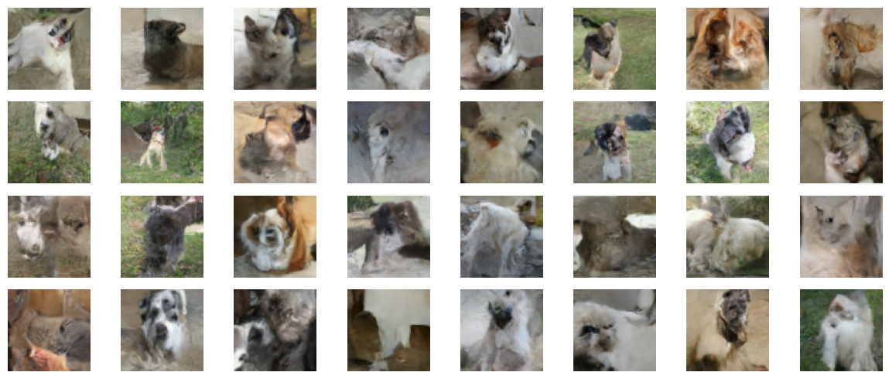
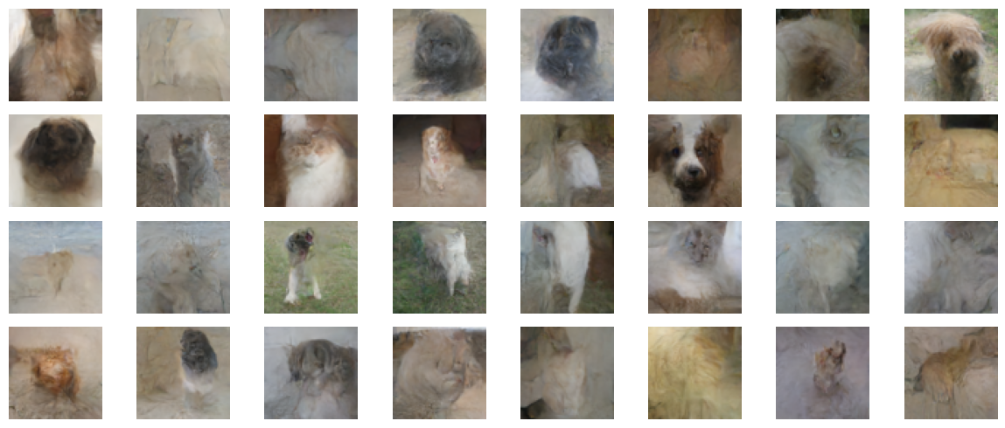

Generated Pets
smaller dataset: 1000-1000 training and validation images
Best KID Model
Overfit Model

Slide 10
Summary
Familiarized ourselves with diffusion models
Implemented denoising diffusion process and U-Net
Trained the model on 2 datasets
Evaluated the models based on 2 metrics: loss and KID
Containerized the solution in Docker
Created flower generating Gradio demo¹
Lessons learned: output activation function, group normalization
Future work: further improve net (attention), complex noise schedule
¹ https://huggingface.co/spaces/Melidon/flower-generation

